Slide 1
YouTube Songs Analysis
Project by
Archana Malviya

Slide 2
Objective-
Analyze likes, comments, views, and their relationships to understand which metrics drive engagement the most.
Identify which videos are most popular based on likes, comments, and views
Analyze how likes, comments, and views evolve over time to identify trends and seasonal patterns.
Understand the demographic and geographic distribution of viewership and engagement.
Explore how users interact with videos (likes, comments, shares) and how these interactions vary across different types of videos.

Slide 3
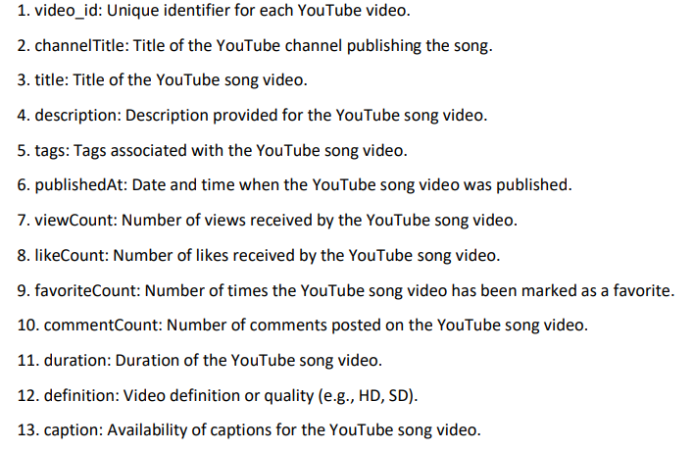
Dataset Description:

Slide 4
Data Cleaning-
Data Cleaning and Preparation: - Clean and preprocess the dataset, handling missing values or outliers.
Convert relevant columns to appropriate data types.
Convert date/time columns to datetime format for accurate time series analysis.
By following these steps, ensure that your dataset is prepared for meaningful analysis

Slide 5
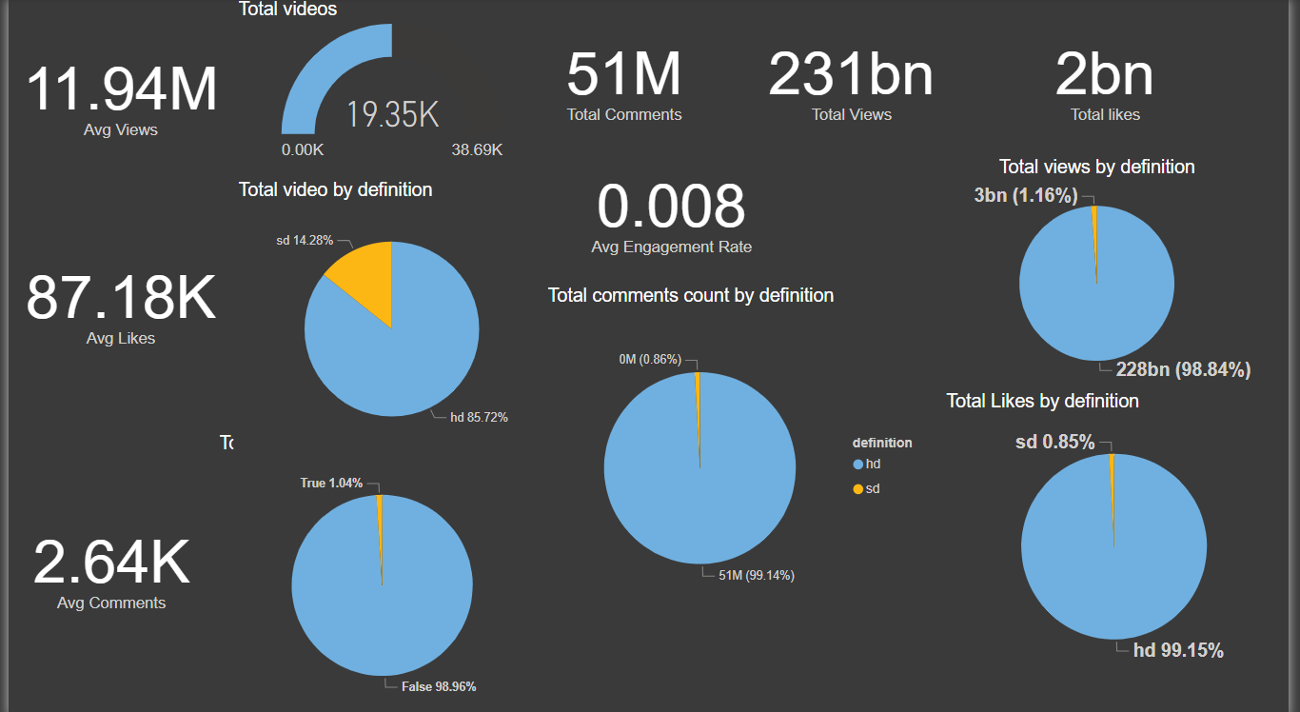
1. Insight Calculated Total Views, Total likes, Total comments as well as Average views, Average likes, Average comments. We can see that in pie chart that mostly videos is watched and likes is came from HD videos, and least for SD.

Slide 6
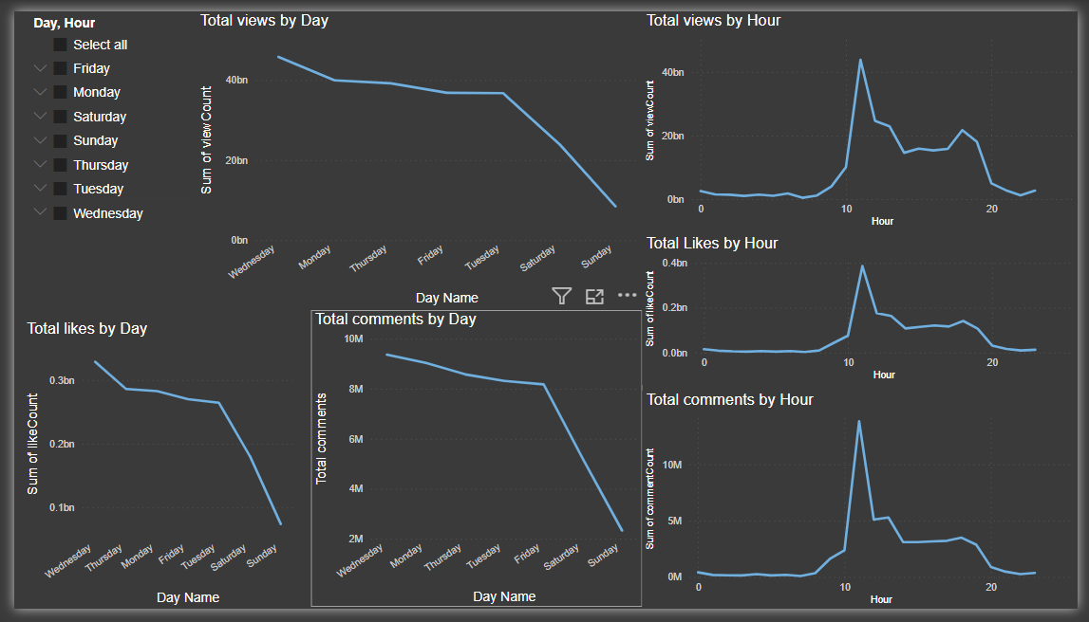
2. Insight- Trends Over Time From this insight we get that total views, total likes, total comment by day and hour. By Day- total views & total likes are highest on Wednesday & Tuesday. Least on Sunday total comments by day is highest on Wednesday & Friday, least on Sunday. By Hour-11 hour is highest

Slide 7
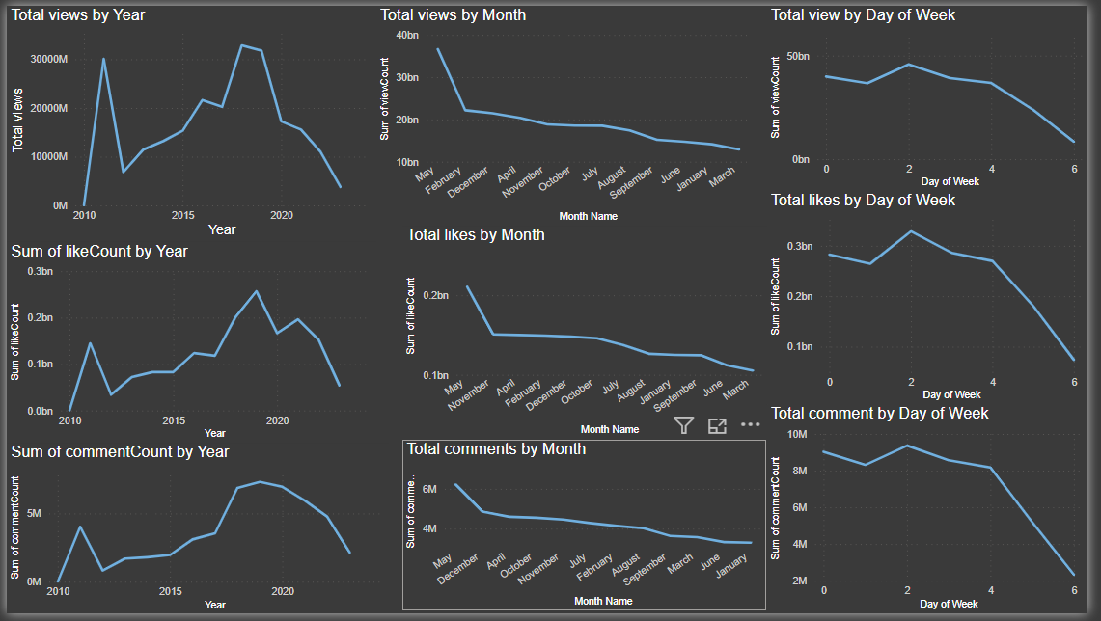
By Year- total views are maximum for 2018, total likes, comments for year 2019. by Month- This trend line start from may which is maximum & goes down till for views –feb, & for likes-nov & for comments is dec & afterwords it decreases. BY Week- day of a week 2 is the highest we got views, likes, and comments.

Slide 8
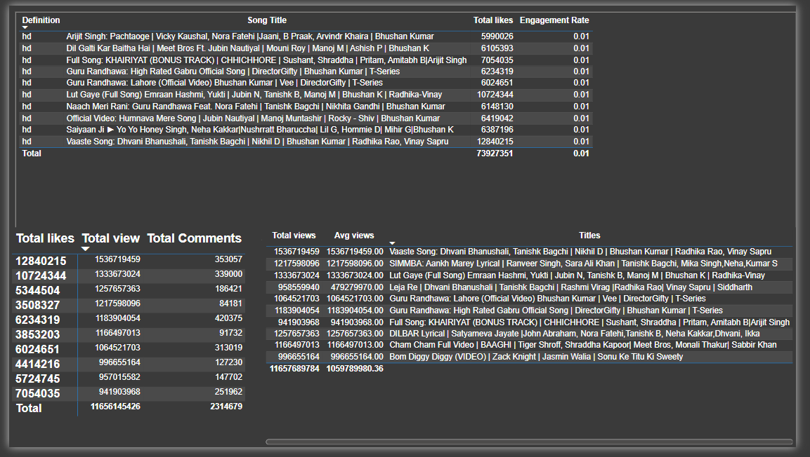
3. Insight Top song title is pachtaoge by Arjit Singh . Most views song is vaaste song.

Slide 9
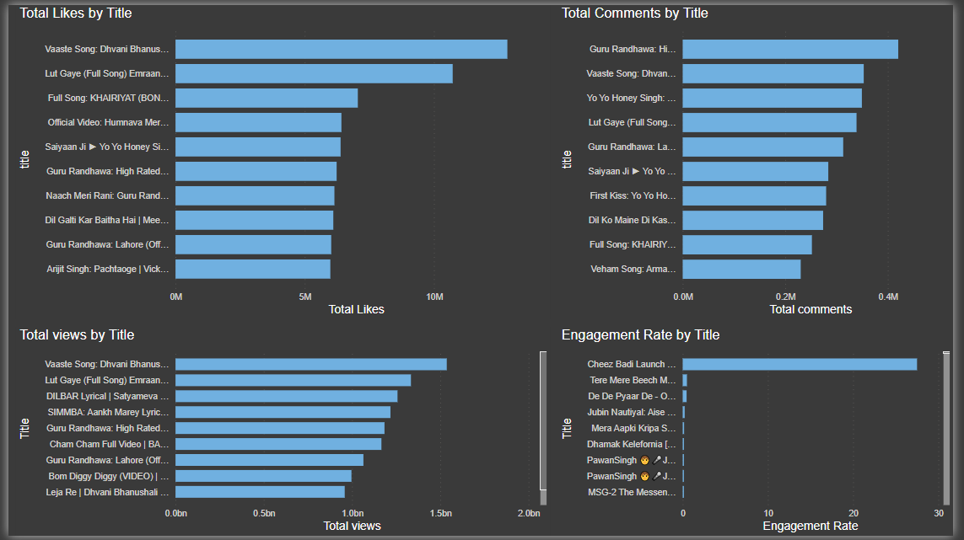
4. Insight- Top Song Videos by Likes, views & comments.

Slide 10
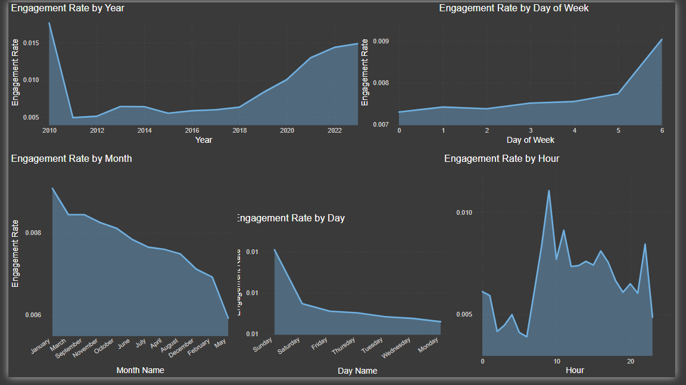
5. Insight

Slide 11
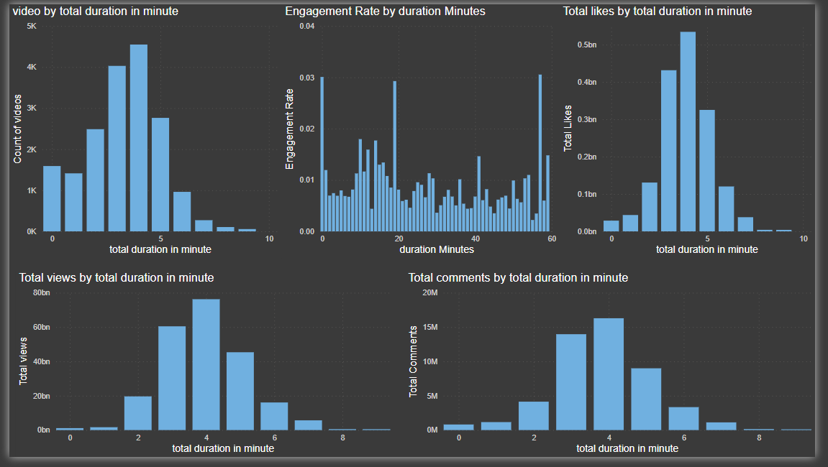
6. Insight-

Slide 12
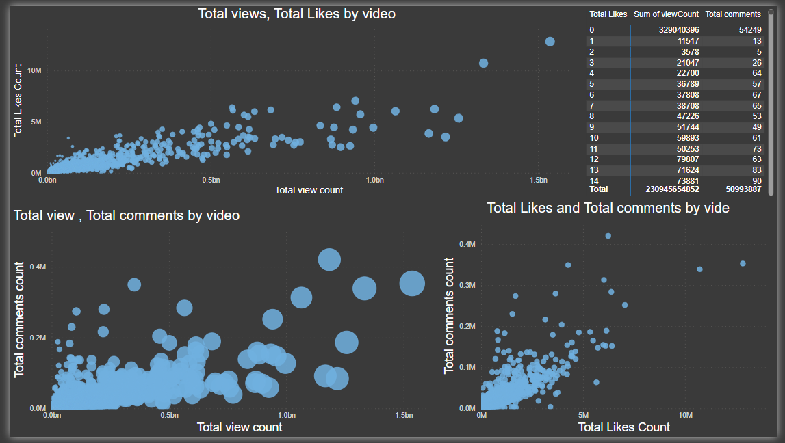
7. Insight-

Slide 13
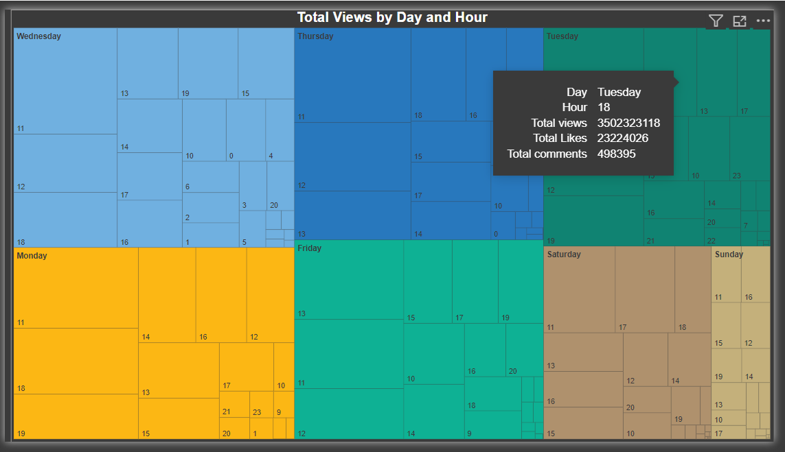
8. Insight-

Slide 14
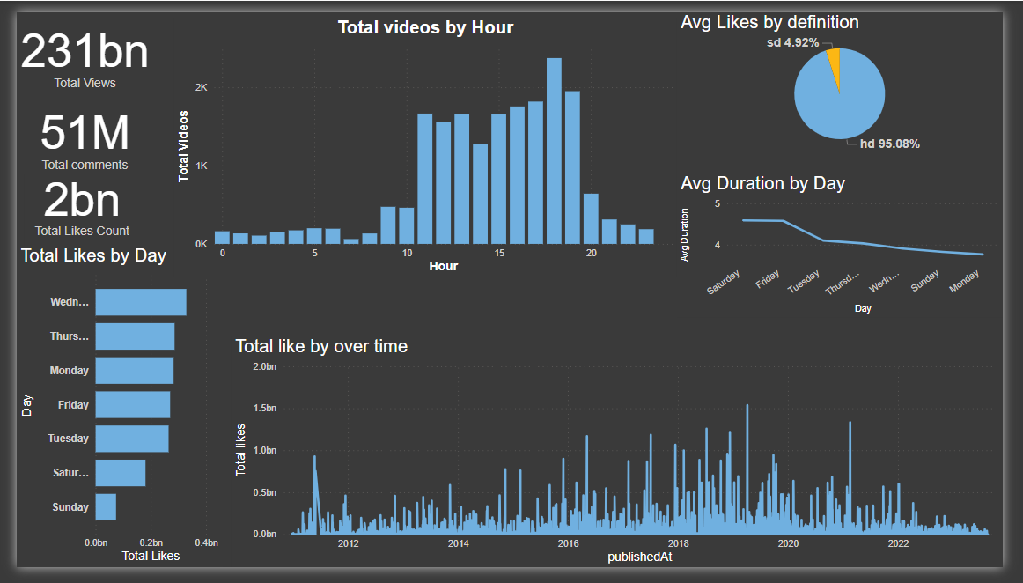
9. Final Analysis-

Slide 15
Conclusion-
Valuable insights into audience engagement, popularity trends.
From Total Views: Understand the overall reach and popularity of the song.
From Total Likes and Comments: Measure audience interaction and sentiment towards the video.
Views Over Time: Identify peaks and troughs in viewer interest.
Likes and Comments Trends: Track engagement trends across different periods.
Also We can see that the top performer song.

Slide 16
Recommendation-
As per Analysis We can conclude that viewers are interested in HD
Quality videos as compare to SD.
Mainly focused on promoting videos and we can short tha videos
As per requirement.
Also can release videos on selected days, hours so maximum viewers can watch it.
Saturday & Sunday are mostly weekday off for viewers so it is good to promote or release the song on this day.

Slide 17
Q & A-
what is the avg comments by month name?
Dec
show me avg views for the last year?
1.33M
show me total likes count for the last year?
5M
top day names by total view count?
Wednesday

